Slide 1
Modelling Across Scales: From Molecules to Pandemics
Molecular Dynamics I
Dr Eleanor Jayawant
Notes:
Last week we heard from Simon about modelling NFkB, this week and next week we’ll be be looking at the smallest of the three scales, molecules, and how we can model them using molecular dynamics simulations. Today will be ~20-25 mins me talking, 15 mins activity, 10 mins discussion at end

Slide 2
Why model molecules?
https://youtu.be/5JcFgj2gHx8?si=pGw1hbmRgHanaHGg&t=207
All-atom Molecular Dynamics Simulation of the Bacterial Cytoplasm
RIKEN and Michigan State University
https://www.youtube.com/watch?v=5JcFgj2gHx8
Notes:
Clip of video made using MD simulations.

Slide 3
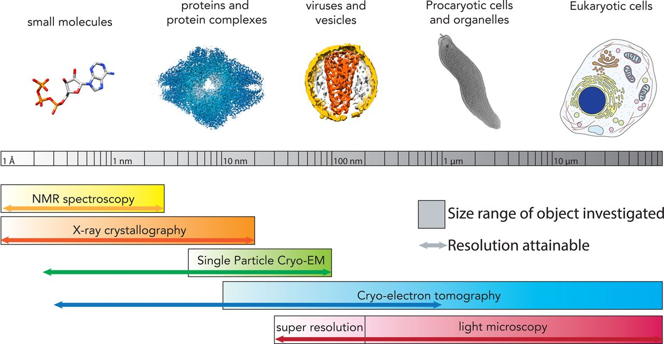
Zooming in on molecules
Hutchings J, Zanetti G. Fine details in complex environments: the power of cryo-electron tomography. Biochem Soc Trans. 2018 Aug 20;46(4):807-816. doi: 10.1042/BST20170351. Epub 2018 Jun 22.
Notes:
Protein structure is the three-dimensional arrangement of atoms in a protein, which is a chain of amino acids. Proteins are polymers – specifically polypeptides – formed from sequences of 20 types of amino acids, the monomers of the polymer. A single amino acid monomer may also be called a residue, indicating a repeating unit of a polymer. To be able to perform their biological function, proteins fold into one or more specific spatial conformations driven by a number of non-covalent interactions such as: hydrogen bonding, ionic interactions, Van der Waals forces, hydrophobic packing.
To understand the functions of proteins at a molecular level, it is often necessary to determine their three-dimensional structure using techniques such as X-ray crystallography, NMR spectroscopy, and others.
There are lots of techniques we can use to study molecules such as proteins, but they all have their advantages and disadvantages. We can think of molecular dynamics simulations as a ‘computational microscope’.

Slide 4
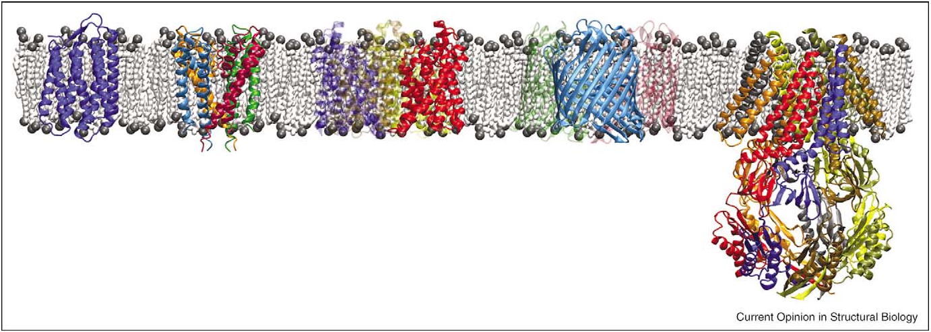
Biological systems are big!
Gumbart J, Wang Y, Aksimentiev A, Tajkhorshid E, Schulten K. Molecular dynamics simulations of proteins in lipid bilayers. Curr Opin Struct Biol.
2005 Aug; 15(4):423-31. doi: 10.1016/j.sbi.2005.07.007. PMID: 16043343; PMCID: PMC2474857.
Notes:
Quantum mechanics calculations can provide information about the behaviour of a system on an atomic and subatomic level, but are so computationally expensive that it is only possible to study a small number of particles (10s of atoms).
As biologically relevant systems are much larger (on the scale of 10^23 atoms), it is necessary to use alternative means to model these systems. Molecular mechanics, or force field theory, involves stripping away detail by ignoring the electronic motions of atoms and allows for the simulation of many-body systems. Although information about quantum effects is lost, molecular mechanics provides an excellent approximation for a wide range of materials.

Slide 5
Anatomy of a force field
Jayawant, E. 2021, PhD Thesis
Notes:
In force field theory, the interaction between particles or atoms is described using a set of parameters which relate the chemical structure to the total energy of the system. A force field is the set of interaction potentials and parameters that describe the forces acting on each type of atom in a system due to its interactions with the other atoms in the system. It is generally broken down into non-bonded and bonded potentials. Bonded interactions include bond stretching, angle bending and torsion angle rotation, and together describe the energy penalties associated with the movement of bonds and angles away from equilibrium. Non-bonded interactions include van der Waals forces and electrostatic interactions, and these describe how atoms that are not covalently bonded together interact through space as a function of distance. The potential energy, V, of a system can be described as a sum of these interaction components as a function of the positions of the particles, r, which is represented by the force field's functional form.

Slide 6
Different types of interactions in MD
Jayawant, E. 2021, PhD Thesis
Notes:
Visual representation of the different interactions that are important in a force field. Molymod example of torsion angles.

Slide 7
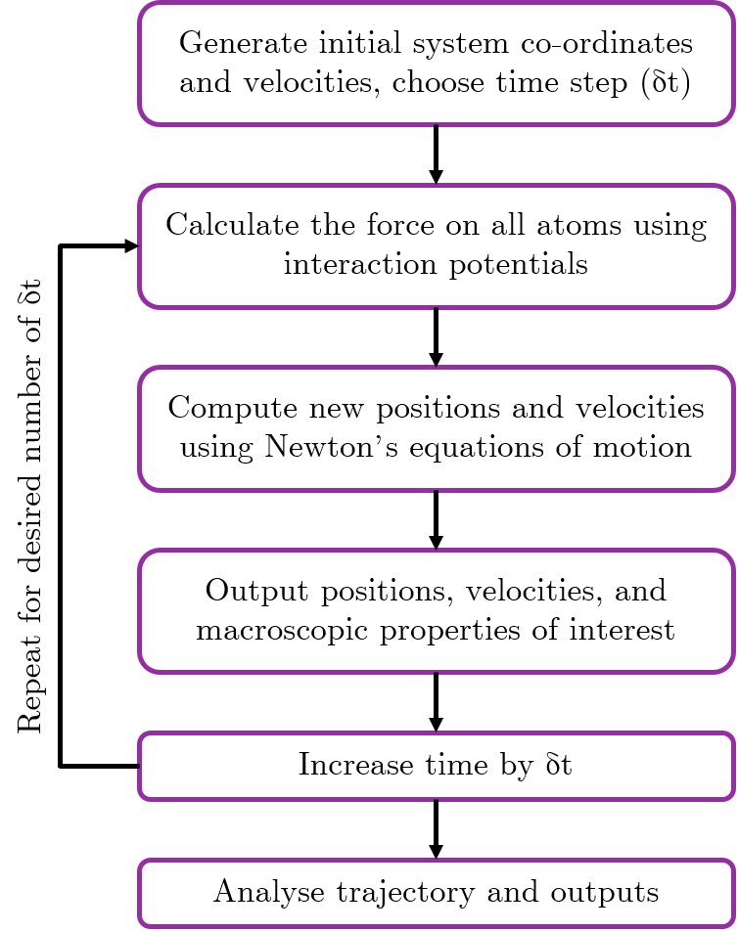
How do simulations work?
Newton’s Equations of Motion:
An object moves in a straight line at constant velocity unless a force acts upon it.
The force on an object is equal to the rate of change of momentum.
For every action there is an equal and opposite reaction.
Jayawant, E. 2021, PhD Thesis
Notes:
In MD, we can use Newton’s equations of motion to describe the dynamics of the atoms in our biomolecule. These three physical laws describe the relationship between a body and the forces acting upon it, and its motion in response.
If we solve the differential equations described by Newton’s second law iteratively for our chosen timestep, we can produce a trajectory which describes how the positions of the atoms change over time.

Slide 8
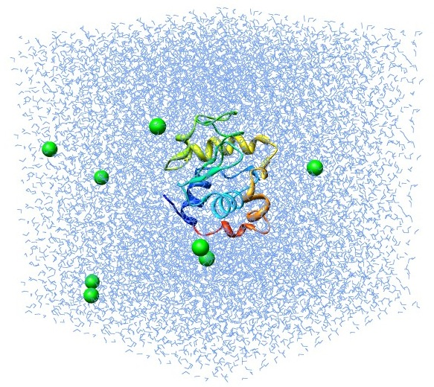
How do simulations work?
Time = 0 ps
Lemkul, J. 2018, GROMACS Tutorial: Lysozyme in Water
http://www.mdtutorials.com/gmx/lysozyme/04_ions.html
Notes:
Choosing the right time step is very important. If the time step is too small, this is computationally expensive and our simulation will take ages, but if it’s too big then the atoms might move too far, collide with each other and the whole system blows up.

Slide 9
How do simulations work?
Time = 0 ps
Lemkul, J. 2018, GROMACS Tutorial: Lysozyme in Water
http://www.mdtutorials.com/gmx/lysozyme/04_ions.html

Slide 10
How do simulations work?
Time = 0 ps
Lemkul, J. 2018, GROMACS Tutorial: Lysozyme in Water
http://www.mdtutorials.com/gmx/lysozyme/04_ions.html

Slide 11
How do simulations work?
Time = 0 ps
Lemkul, J. 2018, GROMACS Tutorial: Lysozyme in Water
http://www.mdtutorials.com/gmx/lysozyme/04_ions.html

Slide 12
How do simulations work?
Time = 0 ps
Temperature = 300 K
Pressure = 1 bar
Energy = 5000 kJ/mol
Lemkul, J. 2018, GROMACS Tutorial: Lysozyme in Water
http://www.mdtutorials.com/gmx/lysozyme/04_ions.html
Notes:
Output some stuff! We need to be able to get out the sort of properties that we might measure in the lab (e.g. temp/pressure/energy of system)

Slide 13
How do simulations work?
Time = 100 ps
Temperature = 300 K
Pressure = 1 bar
Energy = 5000 kJ/mol
Lemkul, J. 2018, GROMACS Tutorial: Lysozyme in Water
http://www.mdtutorials.com/gmx/lysozyme/04_ions.html
Notes:
Increase time by time step, repeat!

Slide 14
Types of MD simulation
Jayawant, E. 2021, PhD Thesis
Notes:
In the early days of MD, the microcanonical (NVE; constant number of particles N, volume V and total energy E; Fig. a) ensemble was traditionally used for MD simulations. In such an ensemble, the system remains isolated and unable to exchange energy or particles within its environment. As a result, these conditions do not closely represent experimental environments, which are typically temperature controlled. Instead, it is more appropriate to maintain a constant temperature T and/or pressure P throughout the simulation, to match more closely to the experimental conditions. For this purpose, more recently the canonical (NVT) and isothermal-isobaric (NPT) ensembles (Fig. b and c) are commonly used. In order to run MD simulations in these ensembles, a thermostat or barostat is necessary to maintain the constant temperature or pressure of the system.

Slide 15
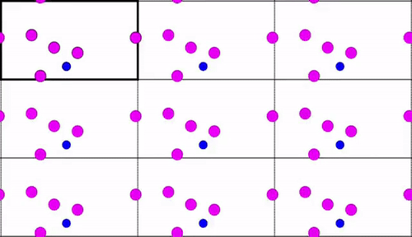
Periodic boundary conditions
To get interesting information, the system must be sufficiently large
This is computationally expensive!
PBCs allow us to use a relatively small number of particles
Particles still experience forces as if they were in a bulk phase
Simulation cell is replicated in all directions, forming an infinite lattice
A particle that moves out of the unit cell is replaced by an image particle from the opposite side
Illustrating periodic boundary conditions, Jan Jensen, https://www.youtube.com/watch?v=5qdNafdyaG0 CC-BY
Notes:
In order to calculate macroscopic properties of a system, the system size needs to be sufficiently large, which is challenging and computationally expensive to simulate. Periodic boundary conditions (PBC) enable a simulation to be performed using a relatively small number of particles, where the particles experience forces as if they were in a bulk phase. The simulation cell is replicated in all directions to form an infinite lattice of identical cells, so a particle that moves out of the unit cell is replaced by an image particle that enters from the opposite side, thus keeping the number of particles within the unit cell constant, and removing any effects due to boundaries to allow for sampling of bulk macroscopic effects. Each atom interacts with any neighbouring atom or image in the periodic lattice within the interaction cut-off specified by the force field. Therefore, it is important that the unit cell is large enough to accommodate the cut-off and prevent an atom from interacting with its own periodic image.

Slide 16
Periodic boundary conditions
To get interesting information, the system must be sufficiently large
This is computationally expensive!
PBCs allow us to use a relatively small number of particles
Particles still experience forces as if they were in a bulk phase
Simulation cell is replicated in all directions, forming an infinite lattice
A particle that moves out of the unit cell is replaced by an image particle from the opposite side
Jayawant, E. 2021, PhD Thesis
Notes:
In order to calculate macroscopic properties of a system, the system size needs to be sufficiently large, which is challenging and computationally expensive to simulate. Periodic boundary conditions (PBC) enable a simulation to be performed using a relatively small number of particles, where the particles experience forces as if they were in a bulk phase. The simulation cell is replicated in all directions to form an infinite lattice of identical cells, so a particle that moves out of the unit cell is replaced by an image particle that enters from the opposite side, thus keeping the number of particles within the unit cell constant, and removing any effects due to boundaries to allow for sampling of bulk macroscopic effects. Each atom interacts with any neighbouring atom or image in the periodic lattice within the interaction cut-off specified by the force field. Therefore, it is important that the unit cell is large enough to accommodate the cut-off and prevent an atom from interacting with its own periodic image.

Slide 17
Activity
Downloading, visualising and manipulating PDB files

Slide 18
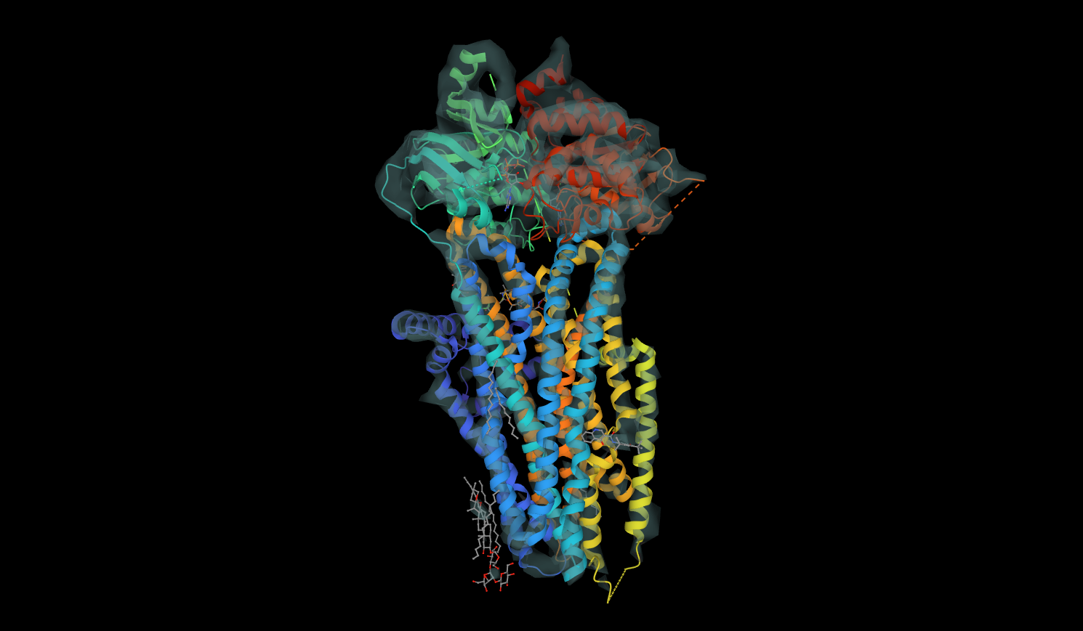
PDB files: what do they look like?
Notes:
https://www.ebi.ac.uk/pdbe/entry/pdb/6o2p - CFTR protein complex with ivacaftor (drug to treat some patients with CF) – you should have learned a bit about CFTR in module 102 (also it looks pretty)

Slide 19
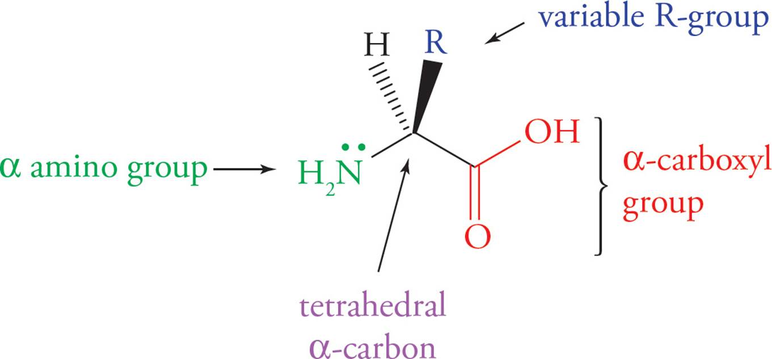
PDB files: what do they ACTUALLY look like?
Column 1: type of record
Column 2: atom serial number
Column 3: atom name
Column 4: residue name
Column 5: chain identifier
Column 6: residue sequence number
Column 7-9: X, Y and Z orthogonal co-ordinates
Final column: element symbol
MCAT Biology and Biochemistry: New for MCAT 2015 (2014), Chapter 3. Biologically Important Molecules https://schoolbag.info/test/mcat_1/3.html
Notes:
PDB files can contain a LOT of extra information, but this is the bit that is totally essential – the actual sequence and co-ordinates. Columns in between co-ordinates and elements are occupancy and temperature factor – these aren’t important for us.

Slide 20
Activity
Task:
Some ideas…
Navigate to Protein Data Bank website
Choose a protein to look at
Use 3D View: Structure to rotate, look at specific atoms, change representations…
Download/display the PDB file (PDB Format)
Find and make a note of the following:
Technique used to generate it
Number of protein chains
Number of residues per chain
Number of atoms in file
Anything else included in the structure (e.g. ligand, other peptide, water etc. )
CFTR: 6o2p
Amyloid-beta fibril: 6w0o
BRCA1 BRCT: 4ifi
Huntingtin: 6ez8
Cyclophilin A: 2rma
NFκB heterodimer: 1le5
Your favourite protein!
https://www.rcsb.org/
Notes:
During the last 10 mins we’ll go around and discuss what we’ve found.
Next week we’ll continue to talk about MD, and will set up and run some basic simulations using much less complicated systems than we’ve just been looking at.

